Slide 1
Smart Sorting: Transfer Learning For Identifying Rotten Fruits And Vegetables
SlideMake.com

Slide 2
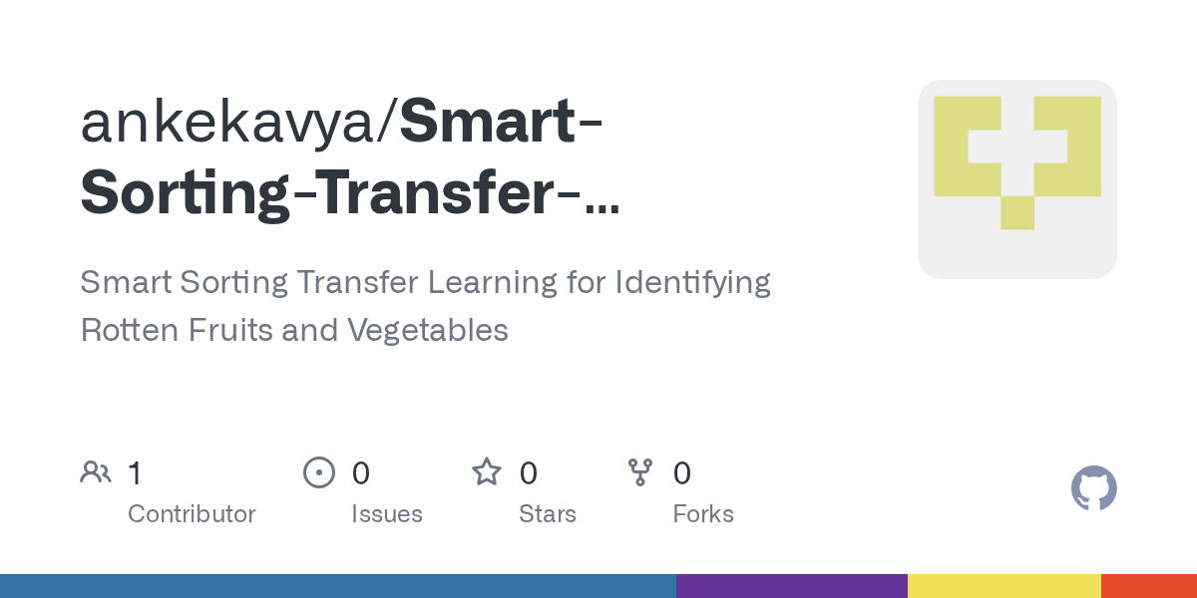
Introduction to Smart Sorting
Smart sorting involves using advanced technology to automate the classification of produce.
It aims to improve efficiency, reduce waste, and ensure quality in the supply chain.
This presentation explores how transfer learning enhances the identification of rotten fruits and vegetables.
Notes:
Image source: https://opengraph.githubassets.com

Slide 3
Importance of Accurate Sorting
Proper sorting ensures only quality produce reaches consumers, maintaining brand reputation.
Detecting rotten or spoiled items early reduces food waste and economic losses.
Effective sorting supports sustainable practices and enhances food safety.
Notes:
Image source: https://opengraph.githubassets.com

Slide 4
Challenges in Traditional Sorting Methods
Manual sorting is labor-intensive, time-consuming, and prone to human error.
Many traditional systems struggle with accuracy when identifying subtle signs of spoilage.
Variability in produce appearance makes automated detection complex.
Notes:
Image source: https://opengraph.githubassets.com

Slide 5
Introduction to Transfer Learning
Transfer learning leverages pre-trained models to solve new but related tasks.
It reduces training time and data requirements for deep learning applications.
This approach is highly effective in image recognition tasks, including fruit and vegetable sorting.
Notes:
Image source: https://opengraph.githubassets.com

Slide 6
How Transfer Learning Works in Food Sorting
Pre-trained models, such as CNNs, are fine-tuned with specific datasets of produce images.
The models learn to distinguish between fresh and rotten items based on visual features.
This method enhances accuracy while minimizing the need for extensive labeled data.
Notes:
Image source: https://opengraph.githubassets.com

Slide 7
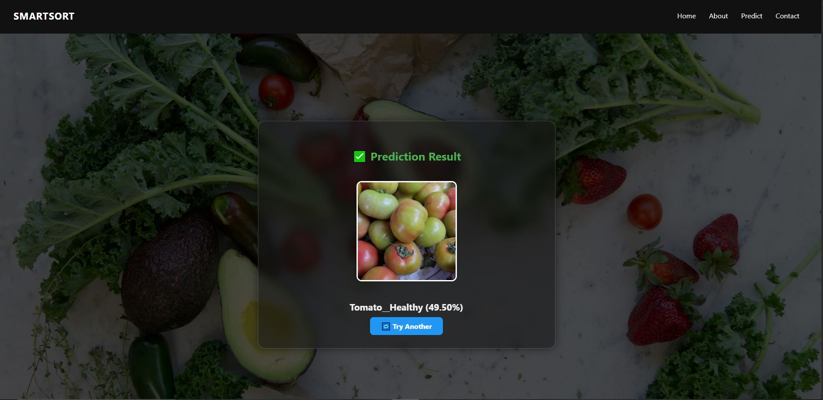
Data Collection and Preparation
High-quality, diverse images of fruits and vegetables are collected for training.
Images are labeled as 'fresh' or 'rotten' to create a reliable dataset.
Preprocessing includes resizing, normalization, and augmentation to improve model robustness.
Notes:
Image source: https://raw.githubusercontent.com

Slide 8
Model Selection and Fine-Tuning
Popular models like ResNet, Inception, and MobileNet are commonly used for transfer learning.
The final layers are replaced or adjusted to classify produce as fresh or rotten.
Fine-tuning involves training the model on the specific dataset while freezing earlier layers.
Notes:
Image source: https://opengraph.githubassets.com

Slide 9
Implementation in Smart Sorting Systems
The trained model is integrated into sorting machinery with cameras and sensors.
Real-time image analysis allows rapid classification of produce on conveyor belts.
Automated systems can sort items immediately based on the model's predictions.
Notes:
Image source: https://opengraph.githubassets.com

Slide 10
Benefits of Transfer Learning in Produce Sorting
Significantly increases the accuracy and speed of sorting processes.
Reduces the need for large datasets and extensive training resources.
Supports scalable, adaptable solutions for different types of produce and spoilage signs.
Notes:
Image source: https://www.mdpi.com

Slide 11
Future Directions and Conclusion
Advancements may include multispectral imaging and IoT integration for even better detection.
Continued research aims to improve model generalization across various produce varieties.
Transfer learning-powered smart sorting offers a promising solution for sustainable food supply chains.
Notes:
Image source: https://opengraph.githubassets.com

